Slide 1


Slide 2
CNN for Text

Slide 3
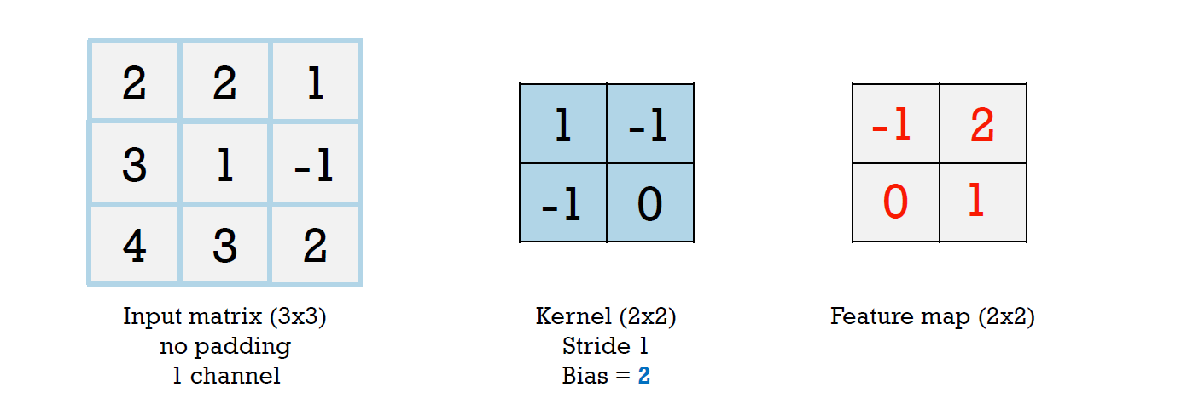
Convolution
It is the cross-channel sum of the element-wise multiplication of a convolutional filter (kernel/mask) computed over a sliding window on an input tensor given a certain stride and padding, plus a bias term. The result is called a feature map.

Slide 4
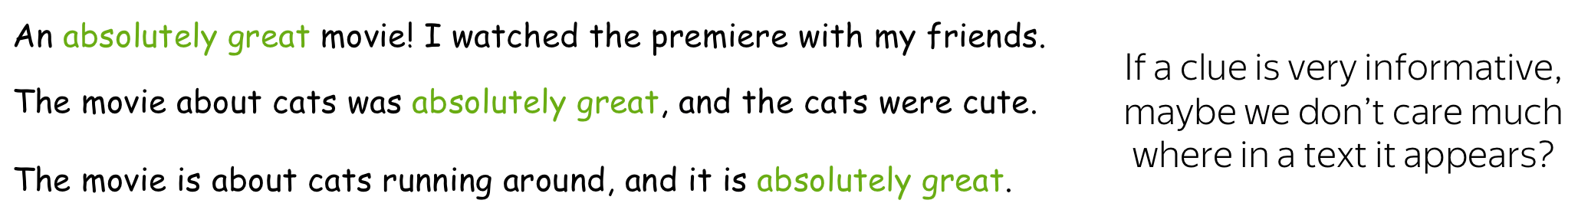

Slide 5
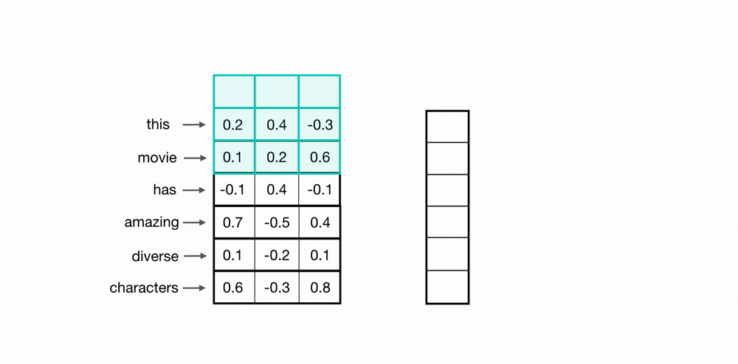
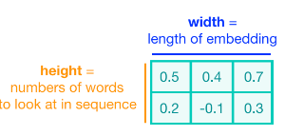
Convolutional Kernels
The height of the kernel will be the number of embeddings it will see at once, similar to representing an n-gram in a word model.
The width of the kernel should span the length of an entire word embedding.

Slide 6
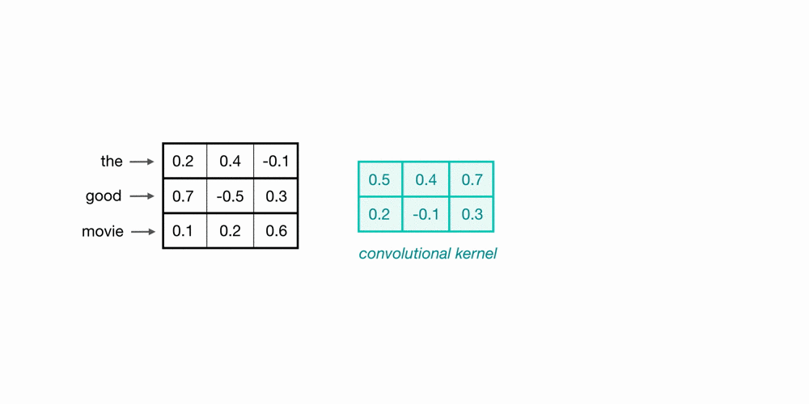
A convolutional neural network will include many of these kernels, and, as the network trains, these kernel weights are learned. Each kernel is designed to look at a word, and surrounding word(s) in a sequential window, and output a value that captures something about that phrase. In this way, the convolution operation can be viewed as window-based feature extraction, where the features are patterns in sequential word groupings that indicate traits like the sentiment of a text, the grammatical function of different words, and so on.

Slide 7
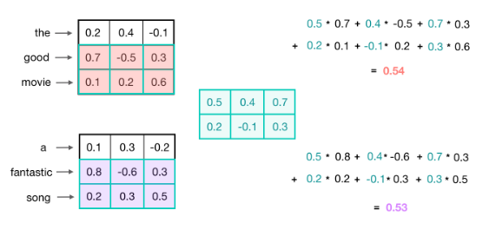

Slide 8
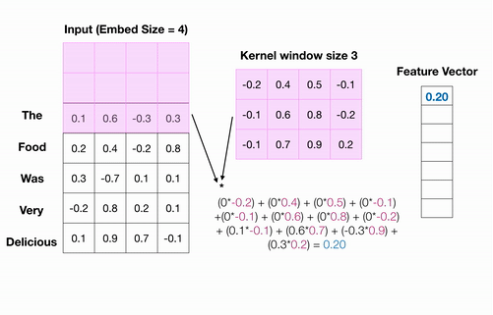

Slide 9

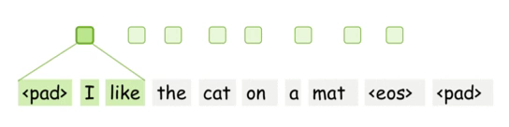
Building Blocks: Convolution
An image has two dimensions (width and height), the convolution is two-dimensional.
Differently from images, texts have only one dimension. Therefore, a convolution here is one-dimensional.

Slide 10
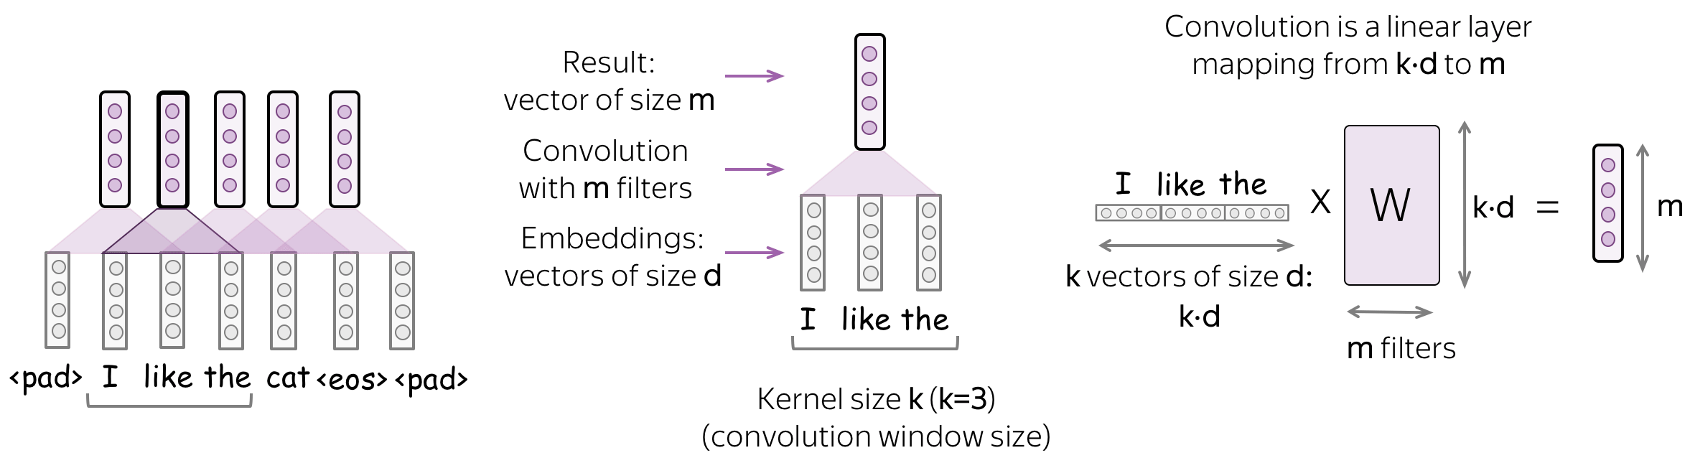
Convolution is a Linear Operation Applied to Each Window

Slide 11
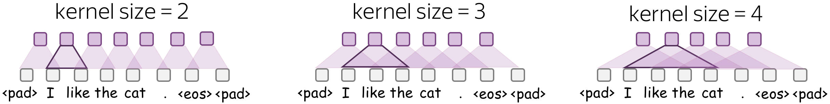
Parameters: Kernel size, Stride, Padding, Bias
Kernel size: How far to look
Kernel size is the number of input elements (tokens) a convolution looks at each step. For text, typical values are 2-5.
Stride: How much move a filter at each step
Stride tells how much to move filter at each step. For example, stride equal to 1 means that we move the filter by 1 input element (pixel for images, token for texts) at each step.

Slide 12
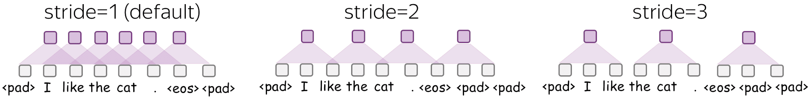
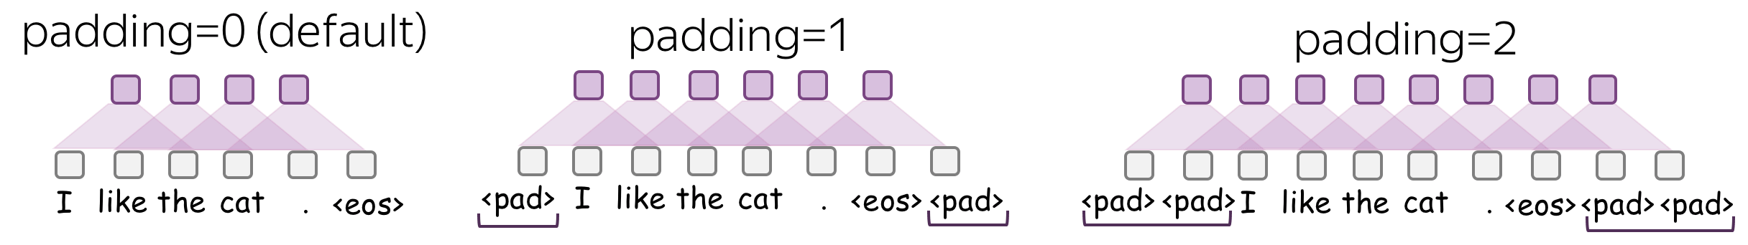
Padding: Add zero vectors to both sides
Padding adds zero vectors to both sides of an input. If you are using stride>1, you may need padding - be careful!

Slide 13
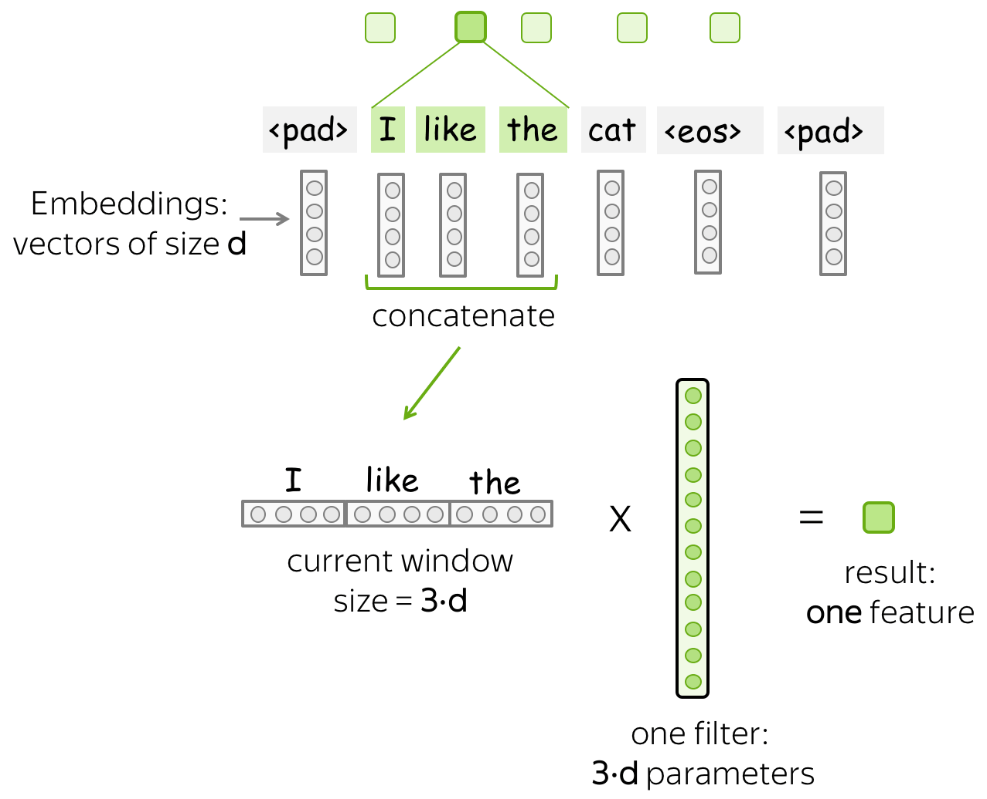
Intuition: Each Filter Extracts a Feature

Slide 14
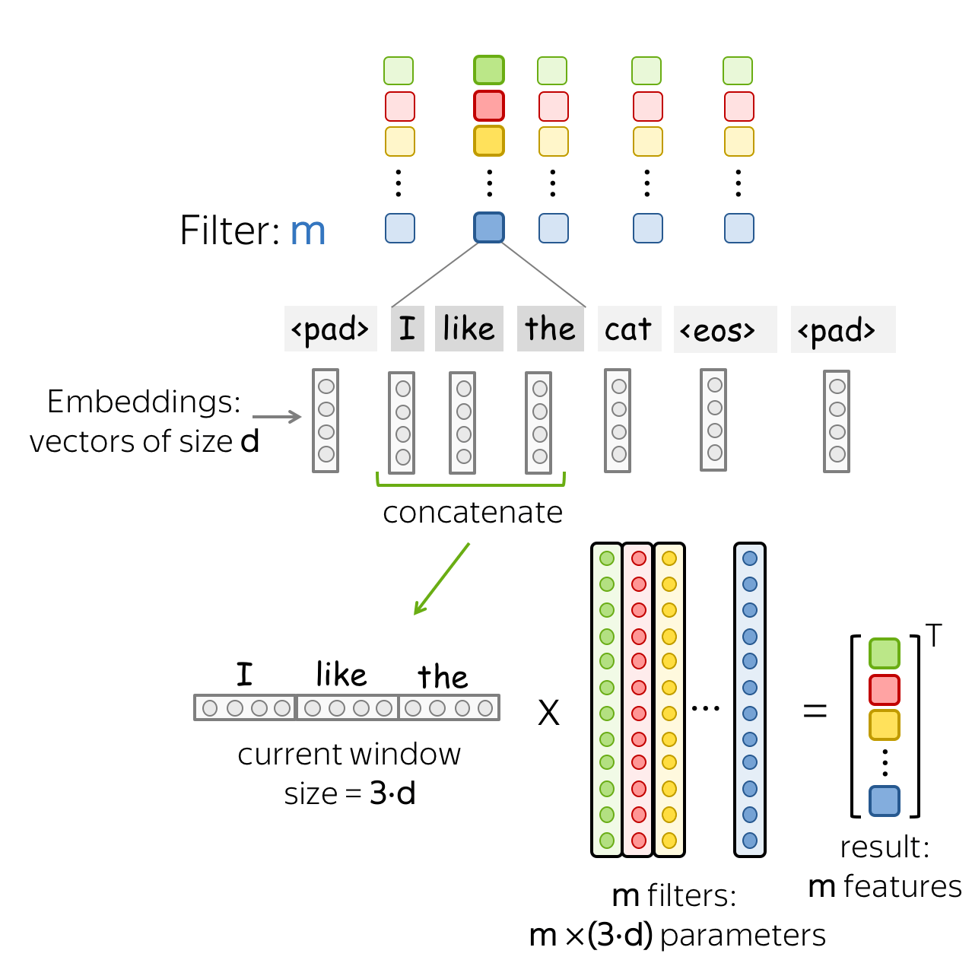
m filters: m feature extractors

Slide 15
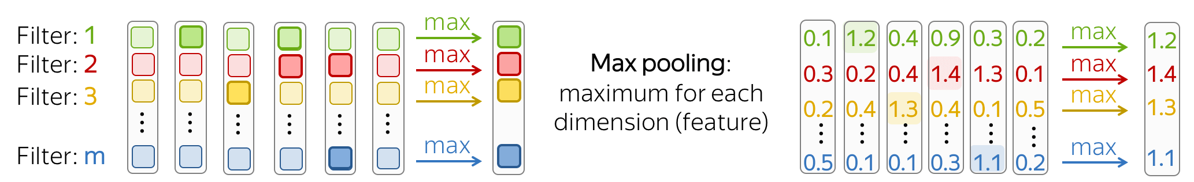
Building Blocks: Pooling
After a convolution extracted m features from each window, a pooling layer summarise the features in some region. Pooling layers are used to reduce the input dimension, and, therefore, to reduce the number of parameters used by the network.
Max Pooling

Slide 16
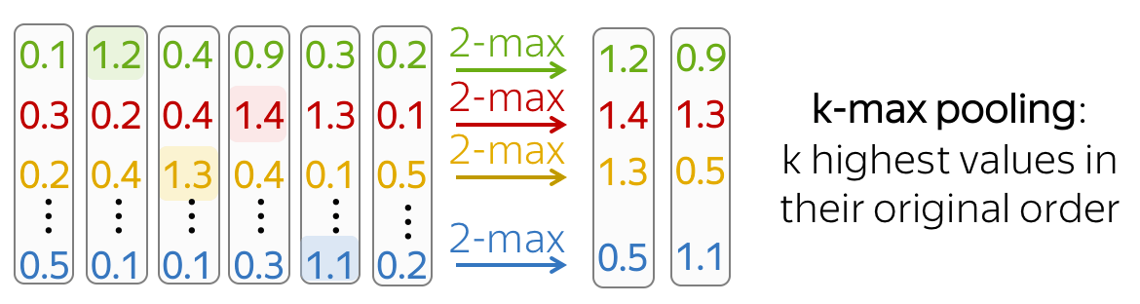
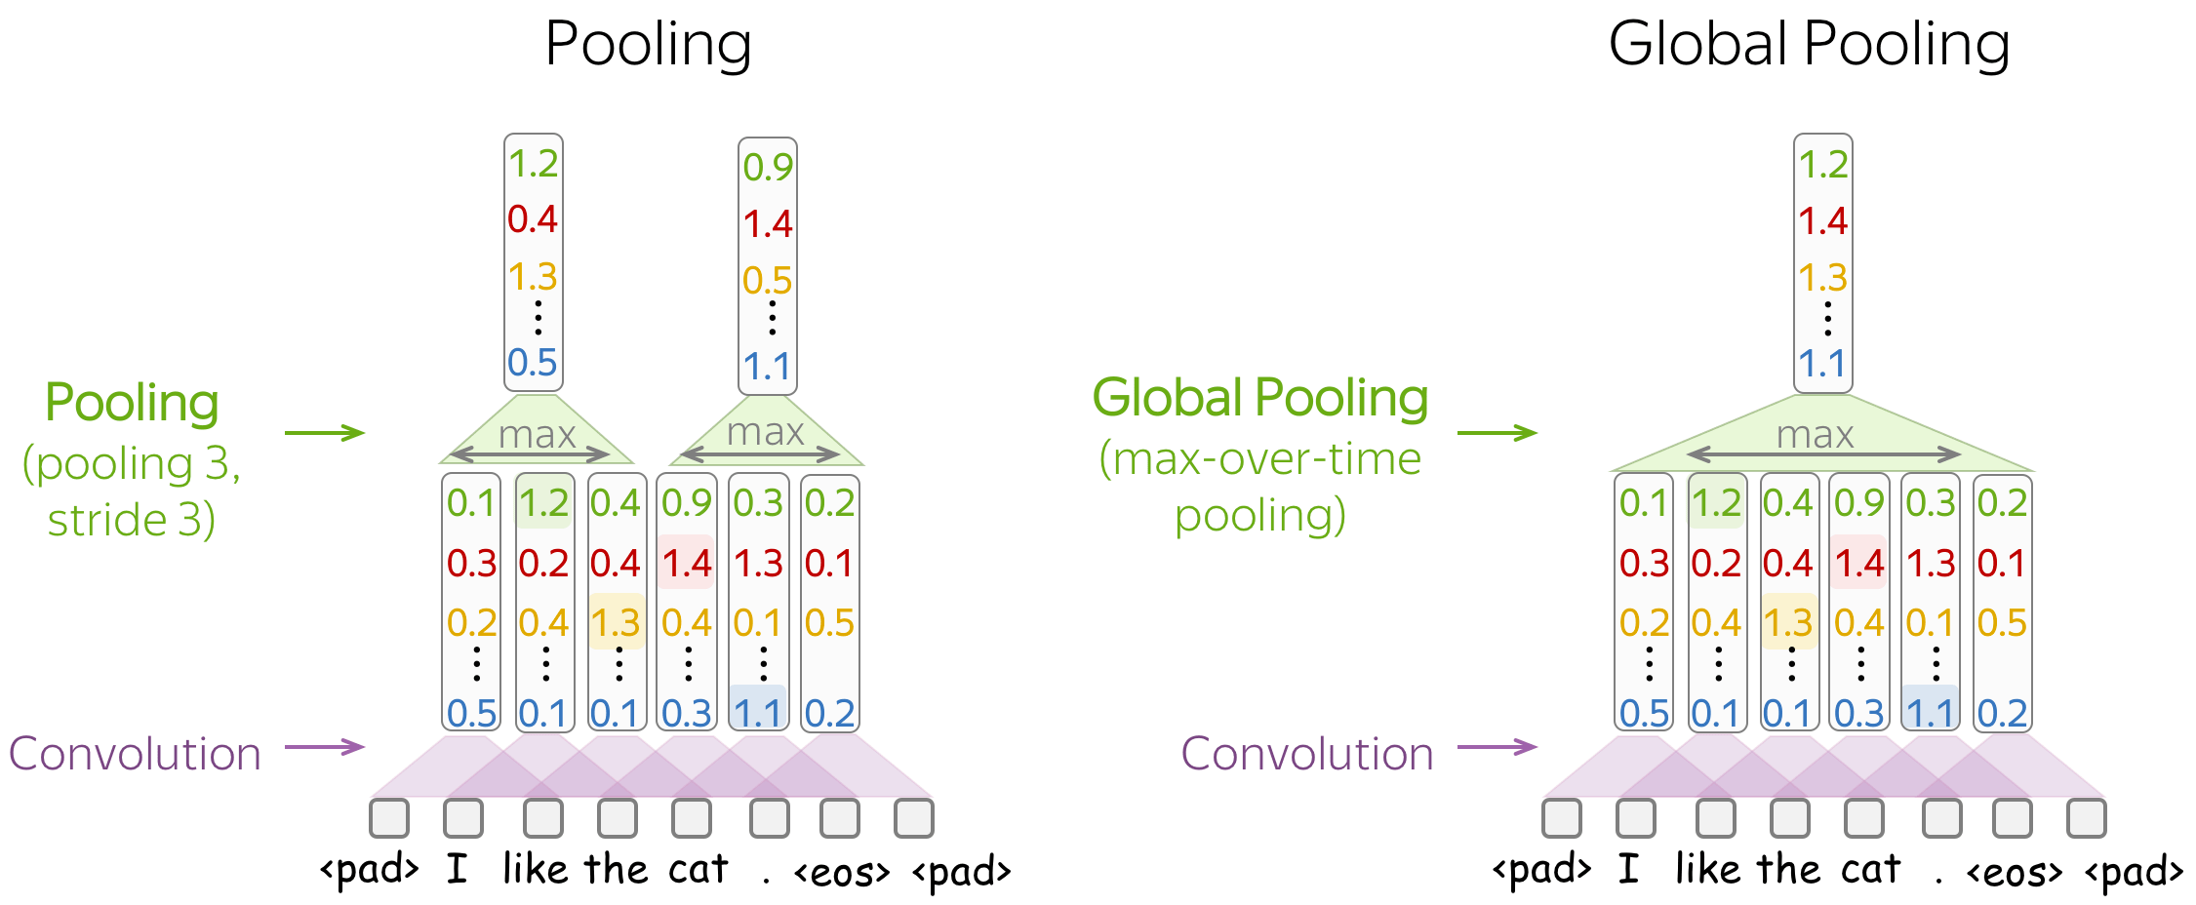
k-max Pooling
Pooling and Global Pooling

Slide 17
References
Convolutional Neural Networks for Text by Lena Voita
CNNs for Text Classification by Cezanne Camacho
Convolutional networks for NLP
Thanks to Ahatesham (ETE’17) for the slides content.

